Slide 1
The Effect of Opposing Information in News on the Reader’s Balance of Opinions
Elena Agapie
May 31st, 2011

Slide 2
The Current Work
Can an interface for reading news make people have a more balanced view of the opinions presented in the news?

Slide 3
Problem Statement & Design
Problem
Statement
Related Systems
Proposed Design &
Related Concepts
Experimental Design
Experiment
Overview
Article Processing
Experimental Design
of Study
Results
Results
Overview
Qualitative Results
Trends in the Data

Slide 4
Problem Statement & Design
Problem
Statement
Related Systems
Proposed Design &
Related Concepts
Experimental Design
Experiment
Overview
Article Processing
Experimental Design
of Study
Results
Results
Overview
Qualitative Results
Trends in the Data

Slide 5
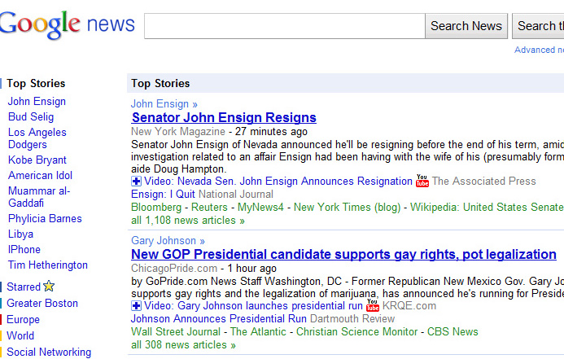
News Online

Slide 6
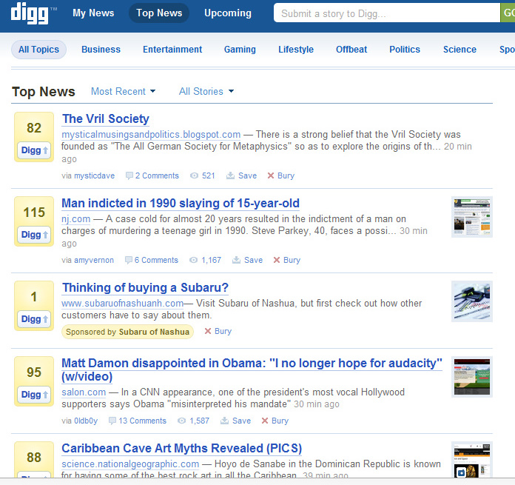
News Online

Slide 7
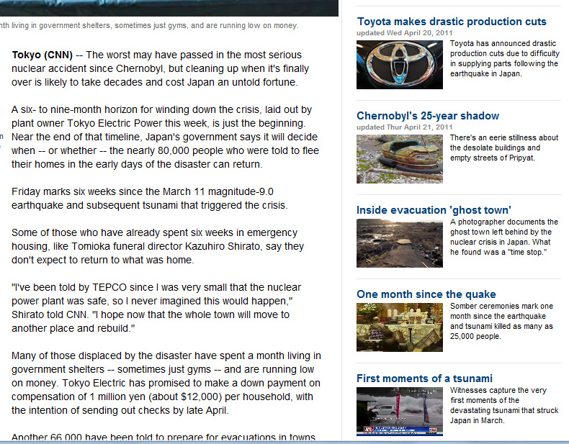
News Online

Slide 8
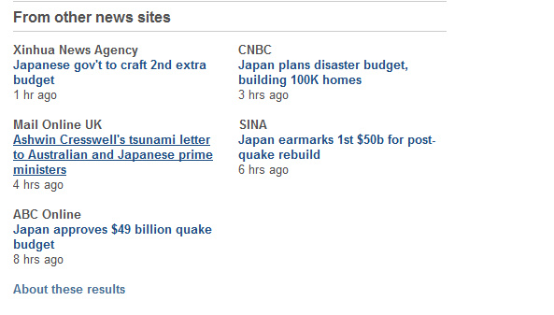
News Online

Slide 9
Problem Statement
be aware of more opinions than the ones in our preferred news?

Slide 10
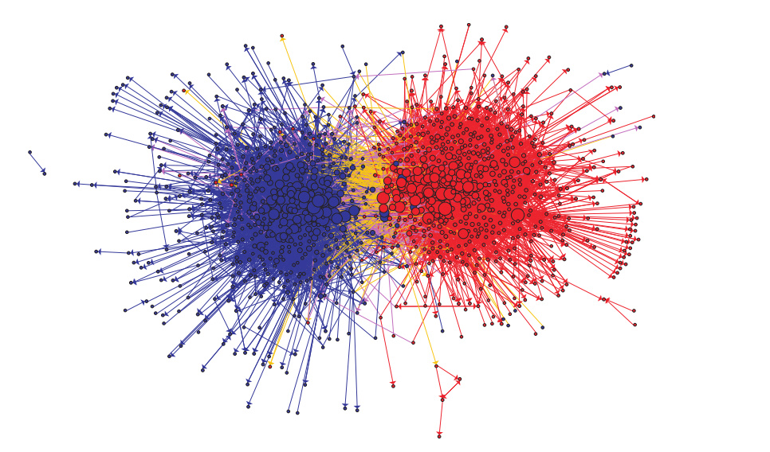
Polarization of Political Blogosphere
Adamic, Lada Glance, Natalie , The political blogosphere and the 2004 US election: divided they blog

Slide 11


Polarization from Information Aggregators
republican news aggregator
conservative YouYube

Slide 12
Problem Statement
How can we improve :
how well the reader comprehends the news articles
do this without requiring significant effort from the side of the reader

Slide 13
Problem Statement & Design
Problem
Statement
Related Systems
Proposed Design &
Related Concepts
Experimental Design
Experiment
Overview
Article Processing
Experimental Design
of Study
Results
Results
Overview
Qualitative Results
Trends in the Data

Slide 14
Related Systems
Presenting and finding diverse opinions
Identifying controversial topics

Slide 15

Tell Me More
Tell Me More, not just “More of the Same”, F Iacobelli, L Birnabaum, K Hammond, IUI

Slide 16
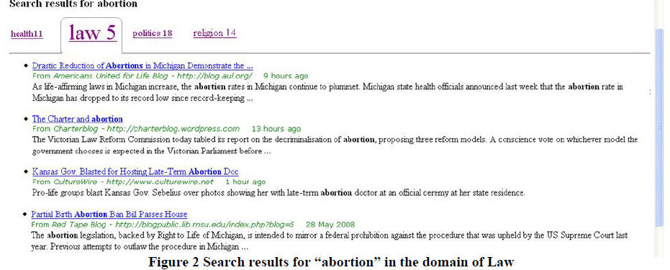
Spectrum
Spectrum: Retrieving Different Points of View from the Blogosphere, Jiahui Liu, Larry Birnbaum, and Bryan Pardo, ICWSM 2009

Slide 17
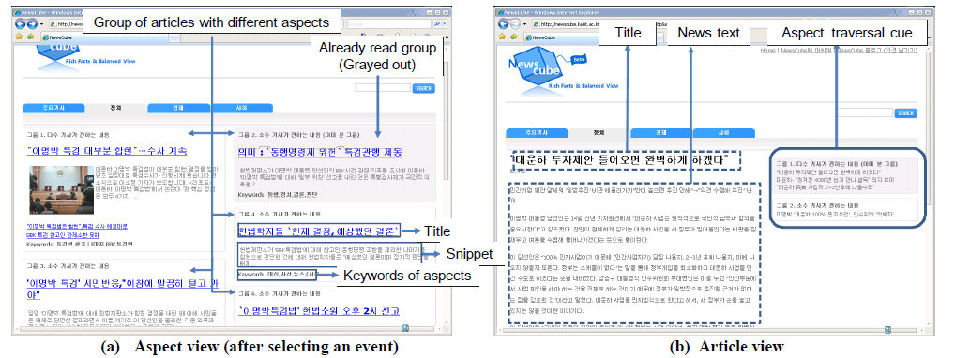
NewsCube
NewsCube: delivering multiple aspects of news to mitigate media bias, S Park, S Kang, S Chung, J Song, CHI 2009

Slide 18
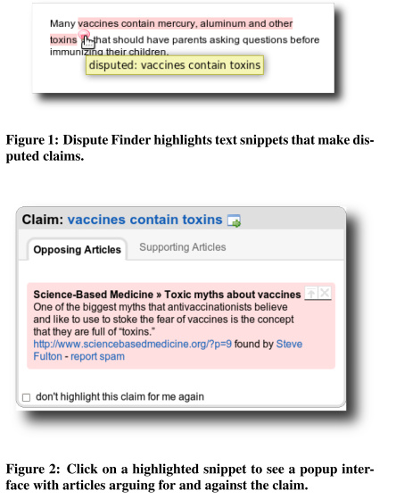
Highlighting Disputed Claims on the Web
Highlighting disputed claims on the web, Ennals, Rob Trushkowsky, Beth Agosta, John Mark, WWW 2010

Slide 19
Contributions of Related Work
Identify Related or Opposing Opinions
Use algorithmic approaches to identify the opinions
Use crowds to identify information
Not primarily focusing on the effect on the user

Slide 20
Problem Statement & Design
Problem
Statement
Related Systems
Proposed Design &
Related Concepts
Experimental Design
Experiment
Overview
Article Processing
Experimental Design
of Study
Results
Results
Overview
Qualitative Results
Trends in the Data

Slide 21
Solution
Provide people with additional information directly linked to the content they are reading
The information comes from different articles, and provides opposing opinions
The design takes into consideration people’s attitudes

Slide 22
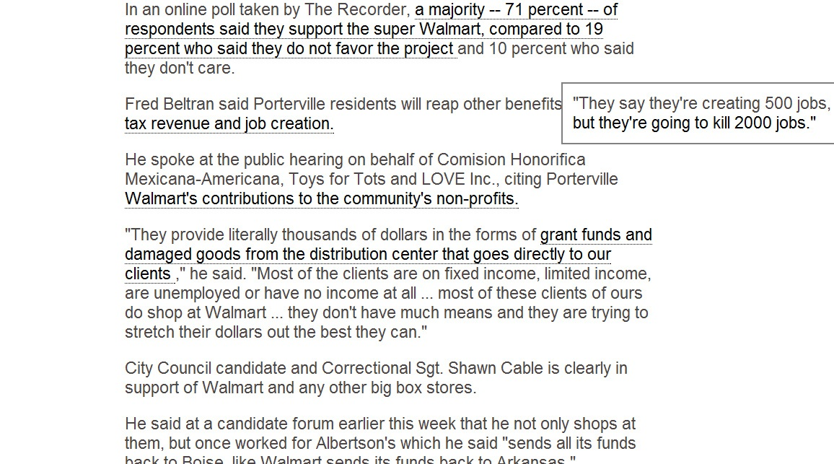
Current Design

Slide 23
Who is the Target Population?
Diversity Seekers readers
Challenge Adverse readers
Presenting Diverse Political Opinion: How and How Much, Sean Munson, Paul Resnick

Slide 24
Challenges
What type of information to provide readers
How to display the information
What mediates the information acquisition of the reader
Attitude of the reader towards the topic
Goal of the reader
Importance of the topic
Media source
Prior Knowledge
Notes:
Information acquisition
Information processing
How to measure the reader’s understanding of the topic and opinions

Slide 25
What Type of Info - Opinion Diversity
Relationship between the number of supporting and challenging items in an article
Highlighting agreeable items or showing them first can increase satisfaction when fewer agreeable items are present
Presenting Diverse Political Opinion: How and How Much, Sean Munson, Paul Resnick, CHI 2010

Slide 26
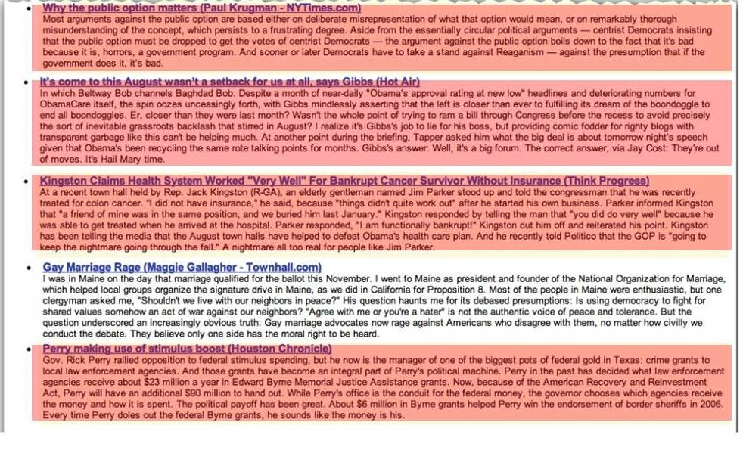
Opinion Diversity
Presenting Diverse Political Opinion: How and How Much, Sean Munson, Paul Resnick, CHI 2010

Slide 27
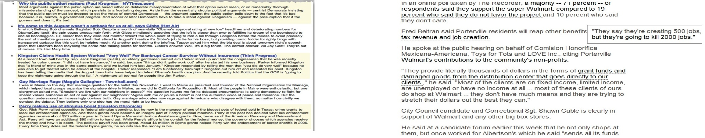
Opinion Diversity

Slide 28
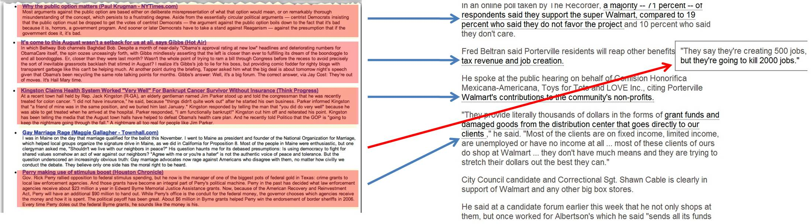
What Type of Info - Opinion Diversity

Slide 29
How to Present Info - Anchored Annotations
Anchored annotation based discussion environments may lead to better conversations about text
Text with negative annotations
Readers spent more effort to verify they comprehend the text
Anchored annotations resulted in better use of compromise - trying to bridge competing positions
Annotations and the Collaborative Digital Library: Effects of an Aligned Annotation Interface on Student Argumentation and Reading Strategies, Joanna Wolfe, International Journal of Computer-Supported Collaborative Learning, 2008

Slide 30
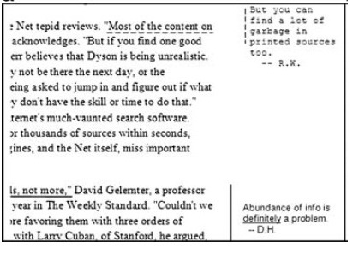
How to Present Info - Anchored Annotations
Annotations and the Collaborative Digital Library: Effects of an Aligned Annotation Interface on Student Argumentation and Reading Strategies, Joanna Wolfe, International Journal of Computer-Supported Collaborative Learning, 2008

Slide 31
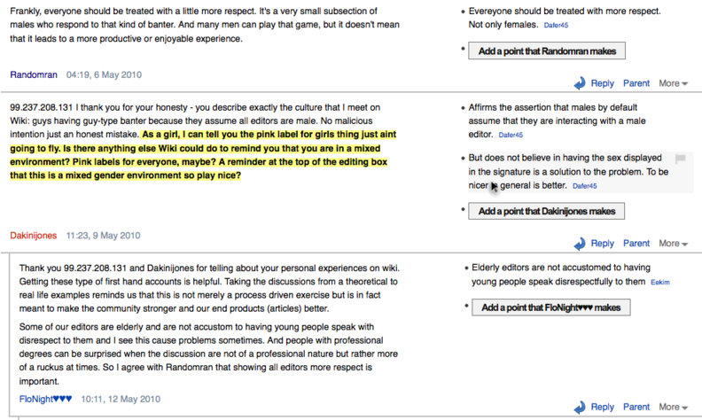
Related Work on Annotations Reflect System
REFLECT: Supporting Active Listening and Grounding on the Web through Restatement, Travis Kriplean, Michael Toomim, Jonathan T. Morgan, Alan Borning, Andrew J. Ko, CSCW 2011

Slide 32
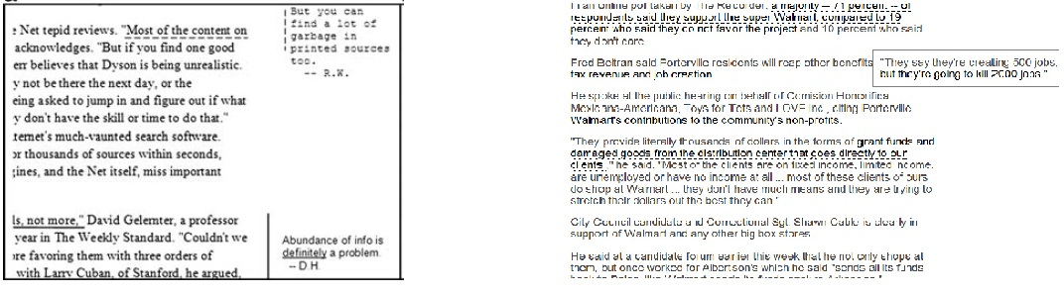
How to Present Info - Anchored Annotations

Slide 33
Mediator of Info Acquisition Attitude Towards Topic
Attitude
An individual’s degree of like or dislike for something
Responses to corrections in mock news articles differ significantly according to subjects’ ideological views
The role of attitude strength as a moderator variable with regard to the direction of the relation attitude - behavior
Strong attitudes are more resistant to change
When Corrections Fail: The Persistence of Political Misperceptions, Brenday Nyhan, Jason Reifler, Political Behavior 2010

Slide 34
Mediator of Info Acquisition Attitude
For the information to be used
Accessible
Chronic accessibility - accessibility of information independent of the particular situation
How frequently used
How it is organized in memory
Frequently activated
Connected to many other nodes in memory
Appropriate
Relevance of the information
Info inappropriate => evaluated opposite to its original implications
Attitudes and attitude change, Gerd Bohner, M. W. Psychology Press, 2002.

Slide 35
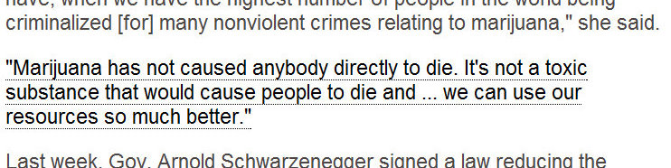
Mediator of Info Acquisition Attitude
Accessible
hover over text

Slide 36
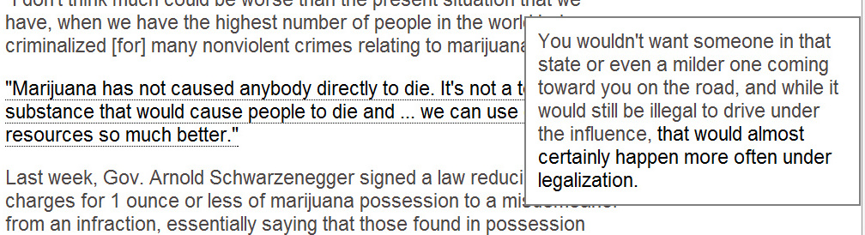
Mediator of Info Acquisition Attitude
Appropriate
Information directly related to original opinion

Slide 37
Problem Statement & Design
Problem
Statement
Related Systems
Proposed Design &
Related Concepts
Experimental Design
Experiment
Overview
Article Processing
Experimental Design
of Study
Results
Results
Overview
Qualitative Results
Trends in the Data

Slide 38
Current Study
Test if by using the designed interface
Reader’s attitudes will be more moderate
Readers will have a more balanced overview of opinions
Readers will make more balanced arguments about the topic they are reading

Slide 39
Current Design

Slide 40
Current Study
Simulate common reading practices
Participants read articles that confirm their opinions

Slide 41
Hypothesis
Reading articles (that confirm user’s opinions) augmented with opposing views
decreases the reader’s immediate strength of their attitude on the article’s topic
increase the reader’s awareness of opinions existing on the article’s topic
increases the balance of pro’s and con’s used in making an argument on the topic

Slide 42
Hypothesis
Reading augmented articles instead of reading the entire source articles
Will provide a similar:
awareness of opinions,
immediate strength of attitude,
complexity of argumentation the reader has on the article’s topic

Slide 43
Experiment Overview
Preparation of materials for the study
Identify topics and articles
Identify the information we want to relate between articles
Experimental Design of the Study
Measurements
Conditions

Slide 44
Problem Statement & Design
Problem
Statement
Related Systems
Proposed Design &
Related Concepts
Experimental Design
Experiment
Overview
Article Processing
Experimental Design
of Study
Results
Results
Overview
Qualitative Results
Trends in the Data

Slide 45
Article Topics
Controversial or debatable topics:
Building a Walmart in your local neighborhood, pros and cons.
California Prop. 19 vote on legalizing marijuana, pros and cons.
Choice of articles
Sets of articles with opposing opinions
Similarity in how strong they are against or favor the issue in the article
Similar size

Slide 46
Article Processing
Rated how extreme the articles are (pro/con) on the topics chosen
Identify all confirming and opposing opinions in the articles
Related each opinion with opposing statements
Asked 4-5 raters for these tasks
Made a consensus

Slide 47
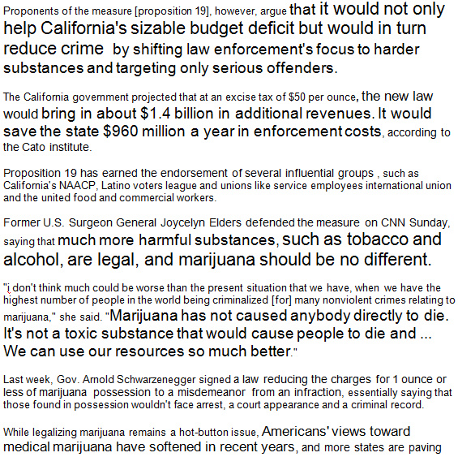
Proposition 19 article – pro legalization

Slide 48
Important issues
Different people have different concepts of what an opinion is and its granularity
It is hard to accurately match opinions 1-to-1 between articles
It is hard to identify what is the best opposing opinion

Slide 49
Problem Statement & Design
Problem
Statement
Related Systems
Proposed Design &
Related Concepts
Experimental Design
Experiment
Overview
Article Processing
Experimental Design
of Study
Results
Results
Overview
Qualitative Results
Trends in the Data

Slide 50
Current Study
Simulate different reading practices
Reading one article confirming one’s attitude
Reading an article augmented with additional opinions
Reading several articles with different orientations

Slide 51
Experimental Design
Pre-survey
Measure attitude of participants
Main Study
Participants Read News Articles
Original Article
Augmented Article
Two Articles
Post Survey
Measure attitude
awareness of opinions
argumentation

Slide 52
Experiment Design
The same design for the Walmart topic
 | Pro Legalization | Counter Legalization
Interface 1 (Original Article)
Interface 2 (Augmented Article)
Interface 3 (2 articles)

Slide 53
Experimental Design
Pre-survey
Measure attitude of participants
Main Study
Participants Read News Articles
Original Article
Augmented Article
Two Articles
Post Survey
Measure attitude, strength of attitude, awareness of opinions, argumentation

Slide 54
Purpose of Pre-survey
Measure attitude on the topic of the articles
Assign participants to the condition in accordance to their opinion

Slide 55
Strength and Orientation of Attitude
Items:
Smoking marijuana for recreational purposes should be forbidden by law.
Legalizing marijuana for recreational purposes would be very detrimental to society.
If it was possible, I would vote for my state legalizing marijuana for recreational purposes.

Slide 56
Experimental Design
Pre-survey
Measure attitude of participants
Main Study
Participants Read News Articles
Condition 1 Topic 1
Original Article
Condition 2 Topic 1
Augmented Article
Condition 3 Topic 1
Two Articles
Condition 1 Topic 2
Original Article
Condition 2 Topic 2
Augmented Article
Condition 3 Topic 2
Two Articles
Post Survey
Measure attitude, strength of attitude, awareness of opinions, argumentation

Slide 57
Condition 1

Slide 58
Condition 2

Slide 59
Condition 3

Slide 60
Experimental Design
Pre-survey
Measure attitude of participants
Main Study
Participants Read News Articles
Original Article
Augmented Article
Two Articles
Post Survey
Measure attitude, strength of attitude, awareness of opinions, argumentation

Slide 61
Strength of attitude
Items:
Smoking marijuana for recreational purposes should be forbidden by law.
Legalizing marijuana for recreational purposes would be very detrimental to society.
If it was possible, I would vote for my state legalizing marijuana for recreational purposes.

Slide 62
Awareness of Opinions
Measurement:
Number of recalled pros and cons from the articles read

Slide 63
Balanced Argumentation
Prompt:
Make a decision on whether marijuana should be legalized. Write an argument listing the most important facts and opinions
Measurement:
Ratio of pros to cons used in a written argument

Slide 64
Informal Interview
Goal:
How did participants perceive the annotations?
What did they think about the interface design
Was the information in the annotations relevant to participants?
Would they want to see this kind of information?
How did they make sense of the information?
How did the participants perceive the articles they were assigned to read?

Slide 65
Problem Statement & Design
Problem
Statement
Related Systems
Proposed Design &
Related Concepts
Experimental Design
Experiment
Overview
Article Processing
Experimental Design
of Study
Results
Results
Overview
Qualitative Results
Trends in the Data

Slide 66
Results Overview
Qualitative results from interview
Informs design decisions
What information to use in the annotations
How did participants like the design?
Quantitative trends from the data
Did the different interfaces have an effect on attitude change, balance of opinions?

Slide 67
Participant Sample
25 participants
Condition 1 (7 participants), Condition 2 (11 participants), Condition 3 (7 participants)
Students at Harvard (mostly graduate students in engineering)

Slide 68
Problem Statement & Design
Problem
Statement
Related Systems
Proposed Design &
Related Concepts
Experimental Design
Experiment
Overview
Article Processing
Experimental Design
of Study
Results
Results
Overview
Qualitative Results
Trends in the Data

Slide 69
Interview Results
Interface Design
Annotations were disruptive (3 participants)
Disturbed the flow of the article
Participants read annotations separately from reading the article
Information overload
Preferred articles that have both pro and counter argument brought together by an editor (1 person)
Preferred a different kind of pointer to additional information
Pointer to an opposing article
Ability to click to go to additional information
Notes:
Keep the flow of the article, more non intrusive
did they participants find them intrusive because they felt they had to click on them?

Slide 70
Implications 1
Make additional annotations unobtrusive
Keep the flow of the article
Think about other ways to point to the additional information

Slide 71
Interview Results
Type of information
Annotations were useful (2 participants)
Contained opposing opinions
They would clarify the original article
Annotations were not useful (3 participants)
They contained opposing opinions
Participants not interested in them
Making sense of the information
Not immediately clear that annotations were opposing opinions
Appropriateness of the information (1 participant)
Additional information is fine in other contexts, but not with opinions
Notes:
Design:
What infor to put in – the 2 types of users
Expectations on what annotations are

Slide 72
Implications 2
Design for different populations (diversity seekers, adverse-resistant)
Make the meaning of the information clear, set an expectation
Opinions are a sensitive aspect on which to point to opposing views. What is the best way to do it?

Slide 73
Interview Results
Perceiving the articles
Article balance
In condition 3 – participants thought the pro and counter article were part of the same article (3 participants)
Articles were neutral with the annotations (1 participant)
Perceived the biased articles as more neutral and stated it was because they had a strong opinion and the article was not as strong as it could have

Slide 74
Implications 3
Expectation of the reader about how balanced the article should be
Readers expecting balanced articles
Readers expecting articles that are as biased as them
How to satisfy all readers and have a balanced amount of opinions?

Slide 75
Problem Statement & Design
Problem
Statement
Related Systems
Proposed Design &
Related Concepts
Experimental Design
Experiment
Overview
Article Processing
Experimental Design
of Study
Results
Results
Overview
Qualitative Results
Trends in the Data

Slide 76
Participant Sample
25 participants
Condition 1 (7 participants), Condition 2 (11 participants), Condition 3 (7 participants)
Students at Harvard (mostly graduate students in engineering)

Slide 77
Results
Attitude Change
Balance of Opinions Recalled
Balance of Opinions used in Arguments
Balance of Opinions reused in Argument

Slide 78
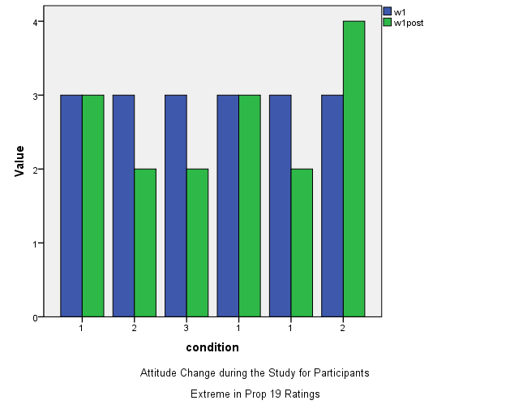
Attitude Change – Moderate vs Extreme Opinionated Respondents
Moderate Participants
Attitude Change
Walmart
Extreme Participants
Attitude Change
Walmart
Pre
Post
Pre
Post
Pre
Post
A B C D E F
(1) (2) (3) (1) (1) (2)
A B C D E
(1) (2) (3) (2) (2)
Participant
(condition)
Participant
(condition)

Slide 79
Attitude Change – Moderate vs Extrem Respondents
Moderate participants
Attitude Change
Legalization
Extreme participants
Attitude Change
Legalization
Pre
Post
Pre
Post
A B C D E F G H
(1) (1) (2) (2) (2) (2) (2) (1)
A B C D E F
(2) (1) (3) (2) (1) (2)
Participant
(condition)
Participant
(condition)

Slide 80
Balance of Opinions
Balance of opinions
Abs ((pro – con ) / (pro + con) )
Balance of Opinions Recalled
Balance of Opinions used in Arguments
Balance of Opinions reused in Argument

Slide 81
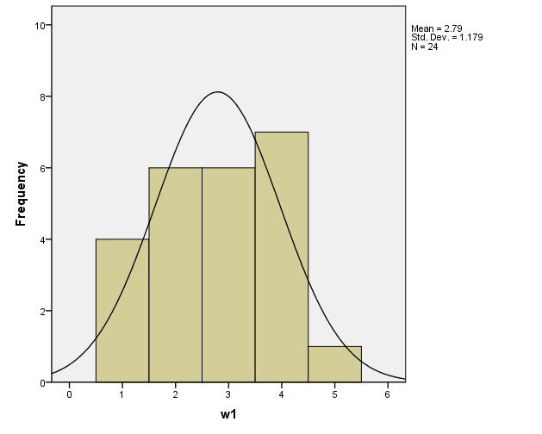
Walmart Attitudes

Slide 82
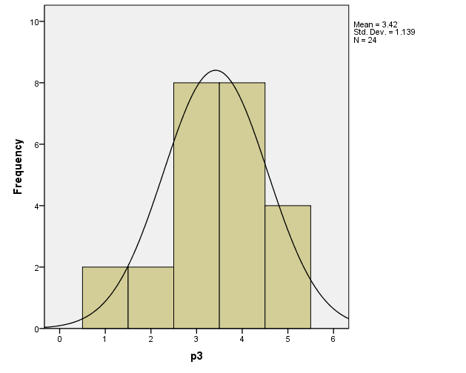
Prop 19 Attitudes

Slide 83
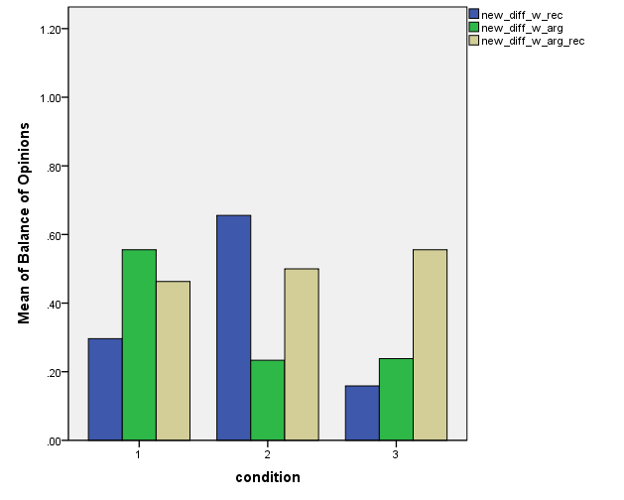
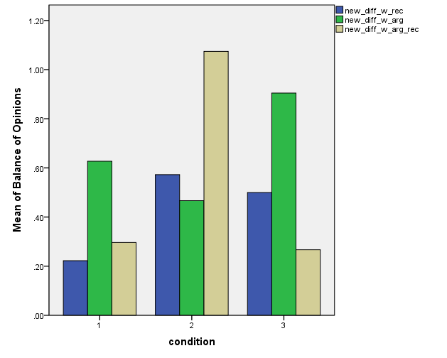
Balance of Opinions – Moderate vs Extreme Participants
Moderate participants
Opinion Balance
Walmart
Extreme participants
Opinion Balance
Walmart
Recall
Argument
Recall Used
Recall
Argument
Recall Used

Slide 84
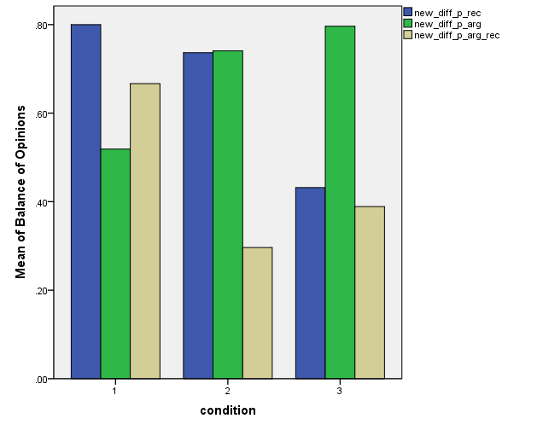
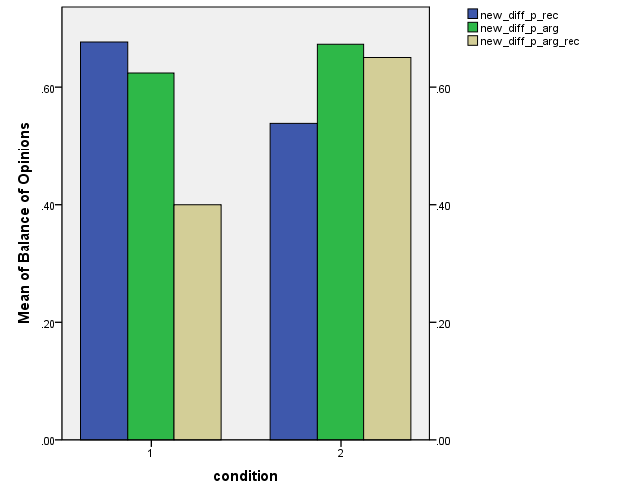
Balance of Opinions – Moderate vs Extreme Participants
Moderate participants
Opinion Balance
Legalization
Extreme participants
Opinion Balance
Legalization
Recall
Argument
Recall Used
Recall
Argument
Recall Used

Slide 85
Discussion
Trend of data is encouraging towards making people’s opinions more balanced
Balance of Arguments – still inconclusive
Important design decision emerged from user feedback

Slide 86
Discussion and Future Directions
Understand data further
Look into data more to see what might cause the current trends
Experiment redesign
Redesign annotation content
Redesign information display
Different ways to point to the information
Make experiment scalable for an online study
Consider topics on which users don’t have a prior opinion
Run follow up experiment on MTurk

Slide 87
Future Directions and Interests
Design of the Interface
Make information accessible
Easy to process
Good user experience
Design of the additional information
What is most useful and relevant?
Opposing facts, additional facts, details to statements, opinions related to statements
How might that differ to different type of news articles?

Slide 88
Future Directions and Interests
Build a system that automates the process of relating information
Can we automate the entire process? NLP challenges
Can we use crowds for part of the article matching?
The best model for building such a system
What combination of human reasoning and automation is appropriate
Redesign the concept so that people can create their own annotations of relevant additional information
How to engage people to participate in creating this body of knowledge?

Slide 89
Thank you!

